Slide 1
Unit: Overview of Atomic theory and Periodic Table
Course: Fundamental Inorganic Chemistry
Credit Hours: 3

Slide 2
Introduction: Inorganic chemistry
Organic chemistry is considered to be the ‘chemistry of carbon’.
Inorganic chemistry is the chemistry of all elements except carbon.
It also studies carbon which plays a major role in many inorganic compounds in the field of organometallic compounds.
Inorganic chemistry is not simply the study of elements and compounds; it is also the study of physical principles.
E.g. in order to understand why some compounds are soluble in a given solvent and others are not, we apply laws of thermodynamics.

Slide 3
Atomic Theories
The search for the atom began as a philosophical question.
It was the natural philosophers of ancient Greece that began the search for the atom by asking such questions as:
What is stuff composed of? What is the structure of material objects? Is there a basic unit from which all objects are made?
As early as 400 B.C., some Greek philosophers proposed that
matter is made of indivisible building blocks known as atomos. (Atomos in Greek means indivisible.)
To these early Greeks, matter could not be continuously broken down and divided indefinitely
The early Greeks were simply philosophers, they did not perform experiments to test their theories

Slide 4
Democritus (400 B.C.)
Democritus proposed that if you kept cutting a substance in half forever, eventually you would end up with an “uncuttable” particle
He called these particles atoms, meaning “indivisible” in Greek
Democritus thought that atoms were small, hard particles of a single material and in different shapes and sizes
He thought that atoms were always moving and formed different materials by combining with each other
Aristotle
The famous philosopher Aristotle, who also lived at that time, argued that all matter was made of only four elements that are fire, water, earth and air
For the next two thousand years, Aristotle overshadowed Democritus
Finally, in the early 1800s, the atomists’ theory was revived by John Dalton

Slide 5
Dalton’s Atomic Theory (DAT)
John Dalton (1766-1844), an English schoolteacher, developed the first useful atomic theory of matter around 1808
His findings were based on experiments and also from laws of chemical combination
Dalton's atomic theory was based directly on the ideas of elements and compounds, and on the three laws of chemical combination.
The three laws are:
Law of conservation of mass: matter is neither created nor destroyed in the course of chemical reaction though it may change from one form to other
The total mass of materials after a chemical reaction is same as the total mass before reaction
Example, in an experiment, 63.5g of copper combines with 16g of oxygen to give 79.5g of cupric oxide (a black oxide of copper)

Slide 6
Law of constant or definite composition: in a given compound, the constituent elements are always combined in the same proportions by mass, regardless of the origin or mode of preparation of the compound
What this law means is that when elements react chemically, they combine in specific proportions, not in random proportions
A sample of pure water, whatever the source, always contains 88.9% by mass of oxygen and 11.1% by mass of hydrogen
Law of multiple proportions: when two elements A and B combine to form more than one chemical compounds then different weights of A, which combine with a fixed weight of B, are in proportion of simple whole numbers
Example, Carbon monoxide (CO): 12 parts by mass of carbon combines with 16 parts by mass of oxygen. Carbon dioxide (CO₂): 12 parts by mass of carbon combines with 32 parts by mass of oxygen. Ratio of the masses of oxygen that combines with a fixed mass of carbon (12 parts) is 16: 32 or 1: 2

Slide 7
DAT
Dalton proved that these laws are entirely reasonable if the elements are composed of tiny particles, which he called atoms
An atom is the smallest fundamental particle of an element
The basic postulates of Dalton’s Atomic Theory are summarized as follows:
All elements are made up of small particles called atoms
Atoms are indivisible and indestructible
All atoms of a given element are identical in mass and in all other properties
Atoms are neither created nor destroyed in chemical reactions
Compounds are formed when atoms of more than one element combine
In a given compound, the relative numbers and types of atoms are constant

Slide 8
J.J. Thomson (1897)
Thomson used a cathode-ray tube to conduct an experiment which showed that there are small particles inside atoms
Thomson’s model was known as the "Plum Pudding Model” ("Raisin Bread Model“)
Two electrodes from a high-voltage source are sealed into a glass tube from which air has been evacuated
When the high-voltage current is turned on, the glass tube emits a greenish light and a beam of light is seen at the anode
In 1897, J.J. Thomson found that the beam was deflected by both electrical and magnetic fields
In an electric field, they bend toward the positive plate.
From this he concluded that the cathode rays are made up of very small negatively charged particles, which he named electrons
He concluded that electrons are constituents of all matter, because the ray was always attracted to the + plate and repelled by - , it was composed of negatively charged matter

Slide 9
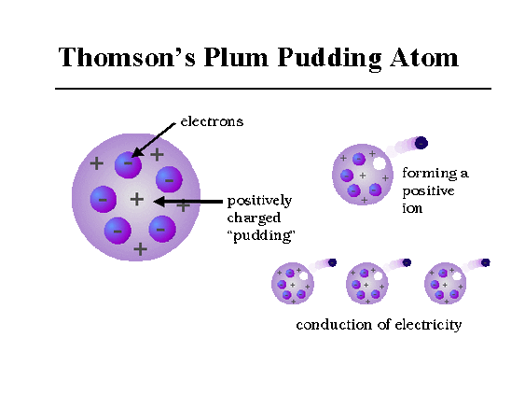


J.J. Thomson (1897)
J.J. Thomson’s experiment led to the precise determination of the charge-to-mass ratio (e–/m) of an electron, and this ‘e–/m’ value was found to be 1.76 × 10⁸ coulomb/g
In 1909, Robert Millikan determined the charge of an electron (e–), using the oil drop experiment.
He found the charge of an electron to be 1.60 × 10^{–19} coulombs
Combinations of e–/m and e– values are used to determine the mass of an electron, which is found to be:
From Thomson’s experiment, e–/m= 1.76 × 10⁸C/g
From Millikan’s experiment, e–= 1.60 × 10^{–19}C

Slide 10
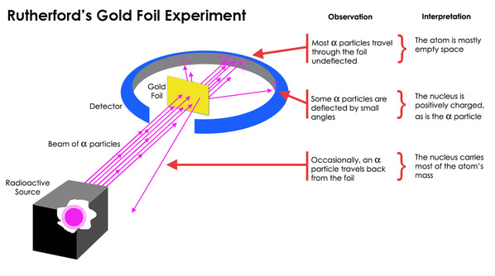
Ernest Rutherford (1871- 1937)
Rutherford performed a series of experiments with radioactive alpha particles
Rutherford fired tiny alpha particles at solid objects such as gold foil.
He found that
most of the alpha particles passed right through the gold foil,
a small number of alpha particles passed through at an angle and
some bounced straight back like a tennis ball hitting a wall
He suggested that the atom consisted of a small, dense core of positively charged particles in the center (or nucleus) of the atom, surrounded by a swirling ring of electrons

Slide 11
Rutherford’s Conclusion
Since most of the α-particles passed through the gold foil undeflected, most of the space in an atom is empty
Some of the α-particles were deflected by small angles. This indicated the presence of a heavy positive centre in the atom, which Rutherford named the nucleus
Only a few particles (1/1,000,000) were either deflected by a very large angle or deflected back. This confirmed that the space occupied by the heavy positive centre must be very small

Slide 12
James Chadwick
In 1932, an English scientist, James Chadwick, identified the existence of neutrons
He bombarded a thin foil of beryllium with α-particles of a radioactive substance
He then observed that highly penetrating rays, consisting of electrically neutral particles of a mass approximately equal to that of the proton, were produced
These neutral particles are called neutrons
A neutron is a subatomic particle carrying no charge and having a mass of 1.675 ×10^{–24}g
This mass is almost equal to that of a proton or of a hydrogen atom

Slide 13
Bohr Model of the Atom
In 1913, Bohr put forward a theory based on quantization of energy to improve upon the Rutherford’s model of the structure of atom
Niels Bohr suggested a new model of the atom that explained why hydrogen had a discrete line spectrum rather than a continuous spectrum
Bohr's basic theory was electrons in atoms can only be at certain energy levels, and
they can give off or absorb radiation only when they jump from one level to another
In his model, an atom consists of an extremely dense nucleus that is surrounded by electrons that travel in set of orbits around the nucleus
He hypothesized that the energy possessed by these electrons and the radius of the orbits are quantized,
meaning it is limited to specific values and is never between those values
These “orbits” were of varying energies, dependent on their distance from the nucleus

Slide 14
Postulates of Bohr Model of the Atom
He postulated that:
1. The electrons move around the nucleus in one of the several fixed circular orbits called energy levels. These energy levels are arranged concentrically around the nucleus, and are characterized by an integer n, the lowest level being given the number 1. The energy level corresponding to n=1, 2, 3, 4,… are also known as K, L, M, N … shells
2. Electrons can move about only in certain orbits which have specific energies. Their movement is possible in only those orbits for which its angular momentum is an integral multiple of h/2π or mvr=nh/2π where ‘n’ is any integer 1, 2, 3, 4….n.

Slide 15
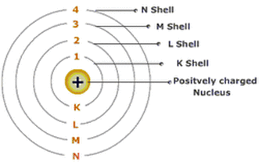
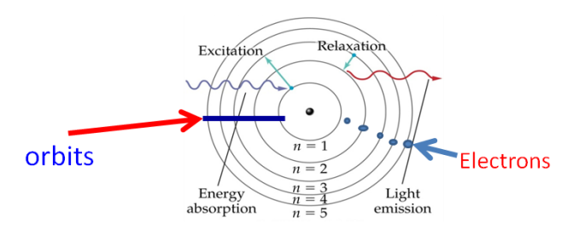
Postulates of Bohr Model of the Atom
3. The energy level nearer to the nucleus has low energy, where as that farthest from it has maximum energy. An electron is said to be in ground state, when it moves in energy level having lowest energy
4. Energy is emitted or absorbed when an electron moves from one level to another
5. When an electron moves from a higher energy (E₂) orbit to a lower energy (E₁) orbit, the energy (∆E = E₂– E₁) is emitted in the form of a photon of frequency v such that ∆E=E₂-E₁=hv

Slide 16
Bohr Model of the Atom
From Bohr model, the energy En of an electron in an orbit n can be calculated by the expression:
The energy difference when an electron in an excited state n =n₂ drops to lower energy state n = n₁ can be calculated as follows:
Therefore,
where R_{H} is the Rydberg constant (2.18 x 10⁻¹⁸J), n_{i} is quantum number describing the lower energy state, and n_{f} is −quantum number describing the higher energy state n_{f} > n_{i}

Slide 17
Some Principles of Quantum Mechanics
Classical mechanics, based on Newton’s laws of motion, successfully describes
the motion of all macroscopic objects such as a falling stone, orbiting planets etc ., which have essentially a particle-like behaviour
However, it fails when applied to microscopic objects like electrons, atoms, molecules etc
This is mainly because of the fact that classical mechanics ignores
the concept of dual behaviour of matter especially for sub-atomic particles and the uncertainty principle
Quantum mechanics deals with dual behaviour of matter
Max Planck and Albert Einstein develops quantum theory of radiation which implies a particle theory of light and wave theory of light required by the phenomena of interference and diffraction

Slide 18
de Broglie Equation
In 1924, Louis de Broglie argued that if light were composed of particles and yet showed wave-like properties,
the same should be true of electrons and other particles. This phenomenon is referred to as wave–particle duality
de Broglie proposed that all moving particles have wave properties.
According to Planck, the photon energy ‘E’ is given by the equation,
E = hν………(i)
Where h is the Planck’s constant and ν the frequency of radiation
According to Einstein’s mass-energy relationship
E = mc²……….(ii)
Where E is the energy associated with photon of mass ‘m’ and c is the velocity of radiation,

Slide 19
de Broglie Equation
Comparing equations (i) and (ii),
Where, λ=wavelength of the particle, h = Planck's constant, m = mass of the particle, v = velocity of the particle.
The de Broglie’s equation is true for all particles, but wave characteristic is of significance only for small particles, such as electrons

Slide 20

de Broglie Equation
b) A body with small mass e.g , subatomic particle such as electron, has a significant value of λ, which can be measured with a suitable device. Let us consider an electron of mass 9.1091x10⁻³¹ kg and moving with a velocity of 1.2x10⁻⁸ cm/sec i.e. 1.2 x 10⁻¹⁰m/sec. The de-Broglie’s wave length λ is given by:
The above value is comparable to the wavelength of x-rays and hence detectable.
Examples,
a) for a body with large mass, the value of λ is found to be too small, to be measured by any instrument. Let us consider a body of mass 10 grams (10x10⁻³kg) moving with a velocity of 1000 m/s. The de Broglie’s wavelength λ is given as follows:
This wavelength is too small to be measured and hence is considered inconsequential.
It can be concluded from the foregoing discussion that everything in nature possesses properties of both the particles and of waves
Q,, What will be the wavelength of a ball of mass 0.1 kg moving with a velocity of 10m/s (Ans. 6.626×10^{–34}m ?

Slide 21
Heisenberg Uncertainty Principle
He stated that it is impossible to describe the motion of an electron in an atom so precisely.
This is a consequence of another fundamental principle of modern physics, Heisenberg's uncertainty principle.
This states that there is a relationship between the inherent uncertainties in the location and momentum of an electron moving in the x direction:
The energy of spectral lines can be measured with great precisions which allows precise determination of the energy of electrons in atoms.
As Δp is small Δx is large.
where, Δx= uncertainty in the position of the electron, Δp= uncertainty in the momentum of the electron.

Slide 22
Heisenberg Uncertainty principle
The precision in energy implies precision in momentum (Δp, is small); therefore,
according to Heisenberg, there is a large uncertainty in the location of the electron (Δx is large).
It means that electron cannot be treated as simple particles with their motion described precisely,
But we must instead consider the wave properties of electrons by a degree of uncertainty in their location.
So we can only describe orbitals rather than describing precise orbits of electrons.
Orbitals- the region of space where the electrons of an atom or molecule are found.

Slide 23
Example,, A microscope using suitable photons is employed to locate an electron in an atom within a distance of 0.1 Å. What is the uncertainty involved in the measurement of its velocity?
Solution,
∆V=0.579×10⁷m/s (1J = 1 kg m²/s²) = 5.79×10⁶m /s

Slide 24
Quantum Numbers
Are parameters that describe the distribution of electrons in the atom, its fundamental nature such as :
the size, energy, shape and position of the orbitals.
There are four types of quantum numbers: principal, angular momentum, magnetic and spin.
Principal Quantum Number (n)
Represents the main energy level, or shell, occupied by an electron. It is always a positive integer that is n= 1, 2, 3...
With the increase in the value of ‘n’, the number of allowed orbital increases and are given by ‘n²’.
All the orbitals of a given value of ‘n’ constitute a single shell of atom and are represented by the following letters.
n | 1 | 2 | 3 | 4……
Shell | K | L | M | N……

Slide 25
Quantum Numbers
Angular Momentum Quantum Number (l)
represents the energy sublevel, or type of orbital, occupied by the electron.
The value of l depends on the value of n such that l= 0, 1,2,... n-1.
For example, when n=1, value of l is only 0. For n=2, the possible value of l can be 0 and 1. For n=3, the possible l values are 0, 1 and 2.
Each shell consists of one or more subshells or sub-levels
The number of subshells in a principal shell is equal to the value of n
Sub-shells corresponding to different values of l are represented by the following symbols
l Value | 0 | 1 | 2 | 3
Notation for sub-shell | s | p | d | f

Slide 26

Magnetic Quantum Number (m_{l})
‘m_{l}’ gives information about the spatial orientation of the orbital with respect to standard set of co-ordinate axis
For any sub-shell (defined by ‘l’ value) 2l+1 values of m_{l} are possible and these values are given by:
m_{l} = – l, – (l –1), – (l –2)... 0,... (l –2), (l–1), l
Thus, for l=0, the only permitted value of m_{l} =0, [2(0)+1=1], one s orbital]. For l=1, m_{l} can be -1, 0 and +1, [2(1)+1=3], three p orbitals] For l = 2, m_{l} = –2, –1, 0, +1 and +2, [2(2) +1 =5], five-d orbitals]
Each orbital in an atom, therefore, is defined by a set of values for n, l and m_{l}
The following table gives the relation between the sub-shell and the number of orbitals associated with it

Slide 27
Spin Quantum Number (m_{S})
represents the two possible orientations that an electron can have in the presence of a magnetic field.
Only two electrons can occupy the same orbital, and they must have opposite spins.
When this happens, the electrons are said to be paired. The allowed values for the spin quantum number m_{S} are +1/2 and -1/2.
Question; what is the total number of orbitals associated with the principal quantum number n=3?
Solution: For n=3, the possible values of l are 0, 1 and 2.
Thus, there is one 3s orbital (n=3, l=0 and m_{l} =0); there are three 3p orbitals (n=3, l=1and m_{l} =-1,0,+1); there are five 3d orbitals (n=3,l=2 and m_{l} = –2, –1, 0,+1, +2). Therefore, the total number of orbitals is 1+3+5= 9.
The same value can also be obtained by using the relation; number of orbitals = n²= 3²= 9.
Exercise; Using s, p, d, f notations, describe the orbital with the following quantum numbers
(a) n= 2, l = 1, (b) n = 4, l = 0, (c) n = 5, l = 3, (d) n = 3, l = 2

Slide 28
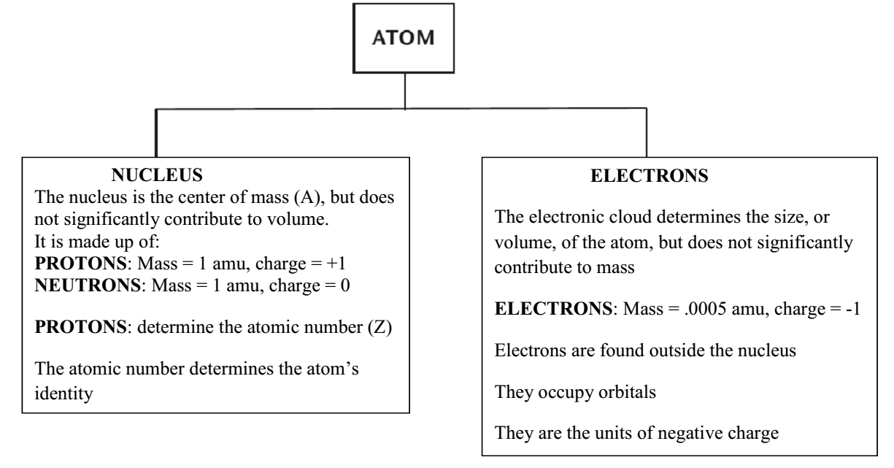
Atomic Structure: Atom
An atom is a basic unit of matter that consists of a dense central nucleus surrounded by a cloud of negatively charged electrons.
Atoms are composed of smaller subatomic particles in an atom. These are proton, neutron, and electron.

Slide 29
Atomic Structure
Inner Structure of an Atom
Nucleus - Small, dense, positively charged center of the atom which contains most of the atom’s mass.
The nucleus contains subatomic particles that have certain characteristics:
Protons - positively charged particles in the nucleus of the atom +
Neutrons - particles in the nucleus that have no charge but contribute to the atom’s mass NEUTRAL 0

Slide 30
Outer Structure of an Atom
Electron cloud - an area encircling the nucleus where electrons are likely to be found.
The cloud contains energy levels.
electrons are negatively charged particles located in specific energy levels.
there is a specific order for the electrons to fill the energy levels.
valence electrons are in the outermost energy level and are the electrons involved in bonding.
valence is the number of bonds that an atom can form.
an atom is most stable when its outermost energy level is full.

Slide 31
Inner and Outer Structure of an Atom
Energy levels completely surround the nucleus.
Maximum of 2 electrons
Maximum of 8 electrons
Maximum of 50 electrons
Maximum of 18 electrons
Proton(+)
Neutron
Maximum of 32 electrons
Nucleus

Slide 32
Atom Characteristics
The number of protons in the nucleus is the atomic number of that atom.
The number of protons (+) equals the number of electrons (-) in neutral atom.
The atomic mass is the mass of the protons plus the mass of the neutrons
Atomic mass is reported in the SI units atomic mass units (amu).
Protons and neutrons each are given an amu of 1.
Electrons have a mass of nearly zero.

Slide 33
Decoding Atom Information
# of protons= # of electrons
8
O
Atom’s
symbol
Atomic mass = # of protons + # neutrons
16.0
Oxygen
Atom’s name

Slide 34
Electron filling of orbitals (Electronic Configuration)
In writing electronic configurations or electron filling of orbitals, we follow the Aufbau principle, Hund’s rule, and the Pauli Exclusion Principle.
The Aufbau Principle (building up principle) -explains the order in which the electrons fill the various orbitals in an atom. Filling begins with the orbitals in the lowest energy to higher energy: 1s,2s,2p,3s…
Hund's rule-states that each degenerate orbital, (e.g.2p_{x}, 2p_{y}, and 2p_{z}) must first receive one electron before any of the orbitals can receive a second electron.
Pauli Exclusion Principle- states that no two electrons can have the same four quantum numbers.
Each orbital contains a maximum of two electrons that must have opposite spin values: spin up (↑, ms=+1/2) and spin down (↓, ms=-1/2).

Slide 35
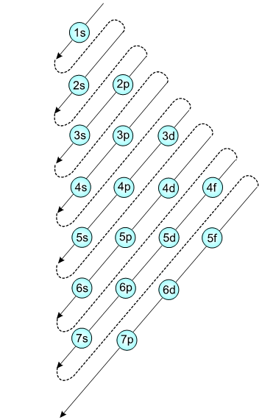
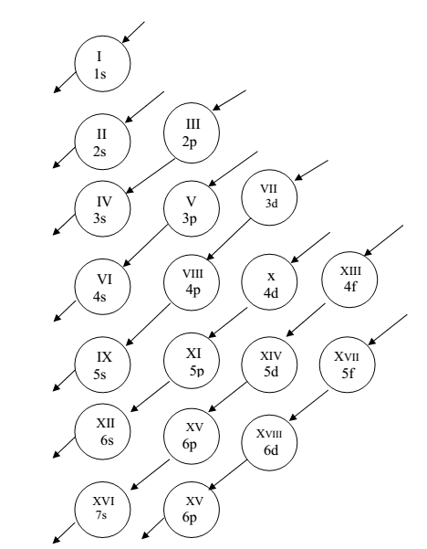
Or
7p

Slide 36
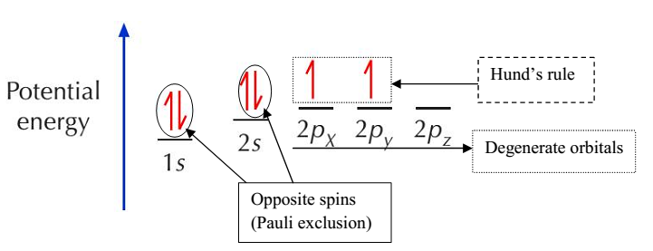
Electron filling of orbitals
Example 1, C has z=6 and its electronic configuration is: 1s², 2s², 2p²

Slide 37
Electron filling of orbitals
Example 2; Nitrogen (N) has z=7, its E.C is 1s², 2s², 2p³, the orbitals are filled as:
Example 3Example 3; Oxygen (O) has z=8,
Its E.C is 1s², 2s², 2p⁴, the orbitals are filled as follows.
Exercise; write the electronic configuration and fill the orbitals of the following elements.
H, He, B, F, Ne and S.

Slide 38
The periodic table: Modern
In 1914 Henry Moseley found a relationship between an element's X-ray wavelength and its atomic number, and
therefore organized the table by nuclear charge (or atomic number) rather than atomic weight
The new order agrees with the chemical properties of these elements
Moseley's research also showed that there were gaps in his table at atomic numbers 43 and 61 which are now known to be Technetium and Promethium, respectively, both radioactive and not naturally occurring
I n the modern periodic table, a horizontal row of elements is called a period, and a vertical column is a group or family.
The traditional designations of groups in the United States differ from those used in Europe.

Slide 39
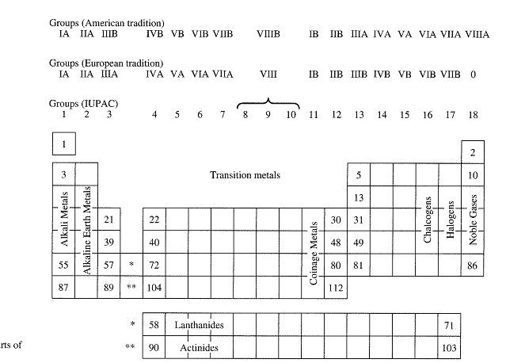

Slide 40
Chemical Periodicity
Periodicity is the recurrence of similar properties at regular intervals when the elements are arranged in increasing atomic number
Chemical periodicity is the variations in properties of chemical elements as depicted by their position in the periodic table
Major chemical trends, horizontally and vertically in the periodic table, can be understood in terms of changing atomic properties
Periodic trends
are specific patterns that are present in the periodic table, which illustrate different aspects of a certain element, including its size and its properties with electrons
The main periodic trends include:
atomic radius,
electronegativity,
ionization energy,
electron affinity,
melting point, and
metallic character.

Slide 41
Atomic Radius
is the distance from the nucleus to the outermost electrons.
It is also one-half the distance between the nuclei of two atoms for different atoms.
Atomic size gradually decreases from left to right across a period due to: all electrons are being added to the same shell.
At the same time, protons are also being added to the nucleus, making it more positively charged.
Going down a group (from top to bottom), it can be seen that atomic radius increases due to the increasing principal quantum number (n).
As a result, the valence electrons are further away from the nucleus
Electron shielding prevents these outer electrons from being attracted to the nucleus
Therefore, they are loosely held and the resulting atomic radius is large.

Slide 42
Electronegativity
A measure of the tendency of an element to attract an electron to itself.
This property exists due to the electronic configuration of atoms
Most atoms prefer to fulfilling the octet rule (having the valence, or outer, shell comprise of 8 electrons)
Since elements on the left side of the periodic table have less than a half-full valence shell, the energy required to gain electrons is significantly higher compared to the energy required to lose electrons.
The elements on the left side of the periodic table generally lose electrons in forming bonds

Slide 43
Electronegativity
Conversely, elements on the right side of the periodic table are more energy-efficient in gaining electrons to create a complete valence shell of 8 electrons.
As we move to the right across a periodic table, electronegativity increases.
As we move down a group, electronegativity decreases due to the atomic number increases down a group

Slide 44
Ionization Energy
The amount of energy required to remove an electron from a neutral atom in its gaseous phase.
The lower this energy is, the more readily the atom becomes a cation and the higher this energy is, the more unlikely the atom becomes a cation.
Generally, elements on the right side of the periodic table have higher ionization energy because of their valence shell is nearly filled (stable)
Elements on the left side of the periodic table have low ionization energies because of their willingness to lose electrons and become cations.
Thus, ionization energy increases from left to right and decreases from top to bottom.

Slide 45
Ionization Energy
Some elements can have several ionization energies: first ionization energy, the second ionization energy, third ionization energy, etc.
The first ionization energy is the energy needed to remove the outermost, or highest energy electron
The second ionization energy is the energy required to remove any subsequent high-energy electron from a gaseous cation
First Ionization Energy: X(g)→X⁺(g)+e−
Second Ionization Energy: X⁺(g)→X²⁺(g)+e−

Slide 46
Ionization Energy
Ionization energies decrease as atomic radii increase and is affected by n (the principle quantum number) and Z_{eff} (effective nuclear charge)
Given by the following equation:
I=R_{H}∗Z²_{eff}/n²
Going across a period, the Z_{eff} increases and n (principal quantum number) remains the same, so that the ionization energy increases.
Going down a group, the n increases and Z_{eff} increases slightly, the ionization energy decreases.

Slide 47
Electron Affinity
The amount of energy released or required to add an electron in gaseous state of an atom or the ability of an atom to accept an electron.
It is a quantitative measurement that measures the energy change that occurs when an electron is added to a neutral gas atom.
When measuring electron affinity, the more negative the value, the more of an affinity to electrons that atom has.
Electron affinity generally decreases down a group of elements because each atom is larger than the atom above (an increase in atomic radius)
Moving from left to right across a period, atoms become smaller (decrease in atomic radius) as the forces of attraction become stronger which causes an increase in electron affinity.

Slide 48
Metallic Character
Refers to the properties of metals and how readily an atom can lose an electron
As we move from right to left across a period, metallic character increases because the attraction between valence electron and the nucleus is weaker
Metallic character increases as we move down a group because the atomic size is increasing.
When the atomic size increases, the outer shells are farther away
The electrons of the valence shell have less of an attraction to the nucleus and, as a result, can lose electrons more readily, causing an increase in metallic character.

Slide 49
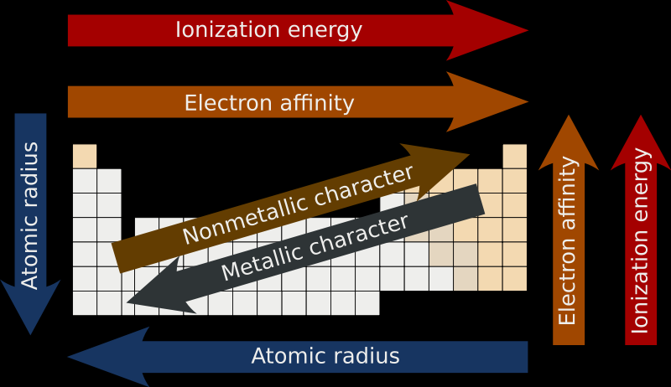
Generally
Elements in the same group have similar chemical and physical properties
Some of the periodic trends are given below.
Electronegativity
Electronyegativit

Slide 50
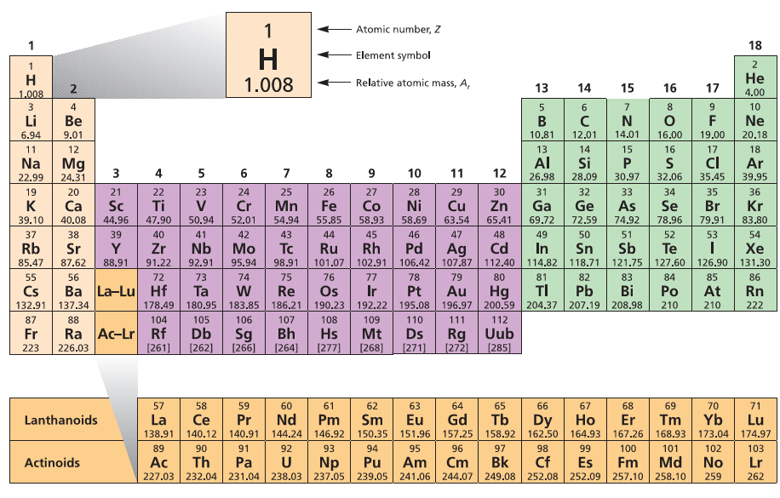

Slide 51
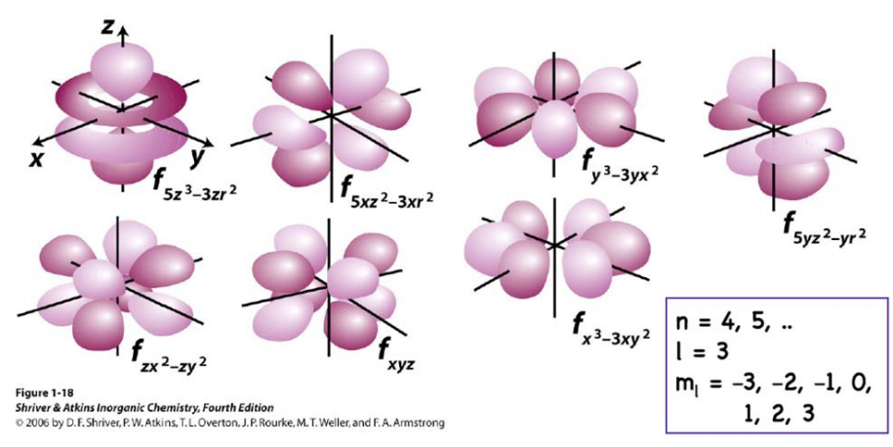

Slide 52
Assignment 1
Write a note and discuss on:
Radial Wave Function and,
Angular wave Function

Slide 53

Our life depends on our attitude: it will be bright like sun rise if we think positively and
it will be darkened like sunset if we think negatively. (HF)

